Slide 1
HCA Data Access
Oct 3rd 2019

Slide 2
Overview
Overview of the HCA data life cycle
Accessing data through the HCA DCP DSS API
  The python dcp-cli
  The Bioconductor HCABrowser Package
Accessing data through the Digested HCA DCP (Azul)
  The data explorer UI
  The Bioconductor HCAExplorer Package
Accessing data through the Matrix Service

Slide 3
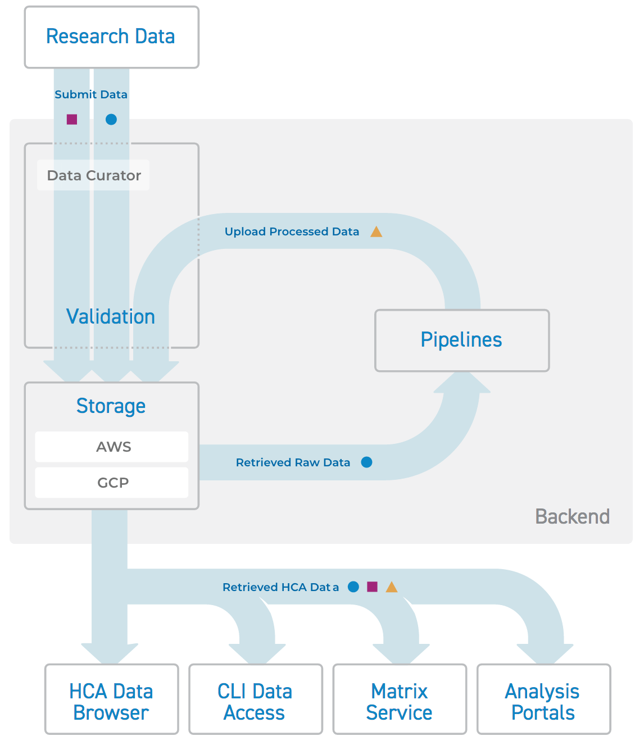
An overview of the HCA data life cycle
https://staging.data.humancellatlas.org/guides/data-lifecycle#introduction
Notes:
Research Data: Labs submit their single cell data and associated metadata.
Data Curator: Submitters work with a Data Curator to upload the data and metadata and ensure it is well formatted and conforms to file format standards. Metadata is also validated as conforming to HCA metadata standards; errors are identified and corrected for re-uploading.
Storage: Validated raw data and metadata files are submitted to the Data Storage System. Storage is provided in both Amazon Web Services (AWS) and Google Cloud Platform (GCP) environments, and data can be accessed from either
Pipelines: Data processing pipelines, approved by the HCA Analysis Working Group, process raw data from some single cell assays, producing matrices and QC metrics files. These pipelines identify genes, quantify transcripts, and assess data quality. Like raw data, processed data are put in the Data Storage System for access by the community.

Slide 4
The HCA Data Coordination Platform Data Storage System (HCA DCP DSS) API
https://dss.data.humancellatlas.org/
A data storage system designed for hosting and large datasets hosted on Amazon S3 and Google Storage.
Provides an API to interact with data: https://dss.data.humancellatlas.org/v1/swagger.json
Defined by a schema: https://schema.humancellatlas.org/a
Certain activities require authorization.

Slide 5
What’s on the HCA DCP
The DCP contains users submitted data.
Four objects to act on
The core unit in the DCP is a bundle:
  Defined with a uuid (string) and a version (string):
    e.g. ffffba2d-30da-4593-9008-8b3528ee94f1.2019-08-01T200147.309074Z
  Contains information relevant to a single experiment
    Metadata
    Schema data
    Experimental data (bam, fasta, etc.)
Bundles contains files:
  Defined with a name (string), a uuid (string), and a version(string):
    e.g. cell_suspension.json
    e.g. ba96ea2d-c7e2-4c47-9561-418a849f93d0
Notes:
The main unit is a “bundle”. Bundles are what are uploaded and primary downloaded by users.

Slide 6
What’s on the HCA DCP (cont.)
Collections are links to files, bundles, and other collections:
  Contains a CollectionItem identified with:
    Type (file, bundle, or collection)
    A uuid
    A version
  A description (string)
  Details of supplementary json information (json)
  A name identifying the collection (string)
Subscriptions support webhook subscriptions for activities like bundle creation, deletion, and updating.

Slide 7
The dcp-cli
A python library and command line interface used to interact with the HCA DCP DSS’s API
Currently the primary way of interacting with the API
Notes:
Talk about how these platforms expose the full range of functionality of the HCA, but are difficult to use and requires knowledge of the underlying metadata schema to navigate.

Slide 8
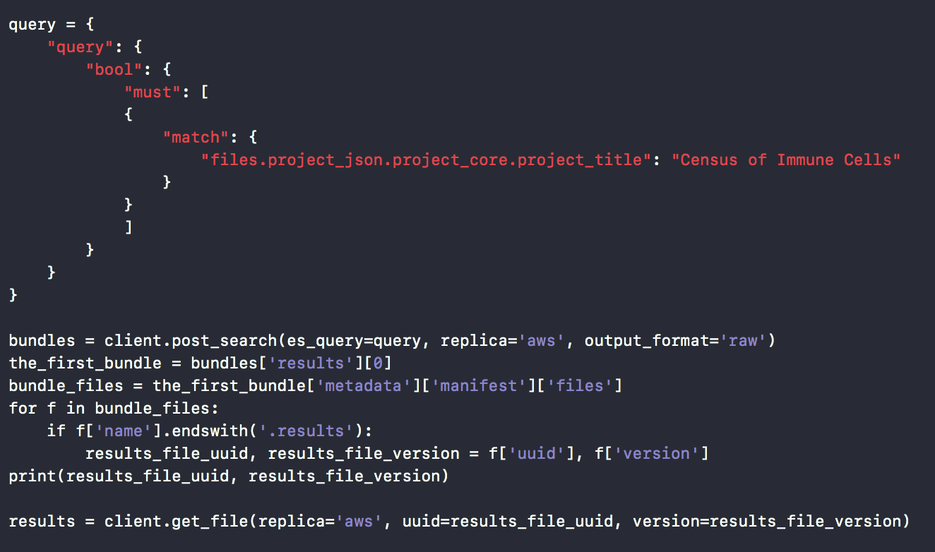
Example

Slide 9
HCABrowser
A Bioconductor Package used to interact with HCA DCP DSS’s API
Meant to mirror the functionality of the dcp-cli
Utilizes `rapiclient` to facilitate access to the API
Improvements planned for the Bioconductor 3.10 release

Slide 10
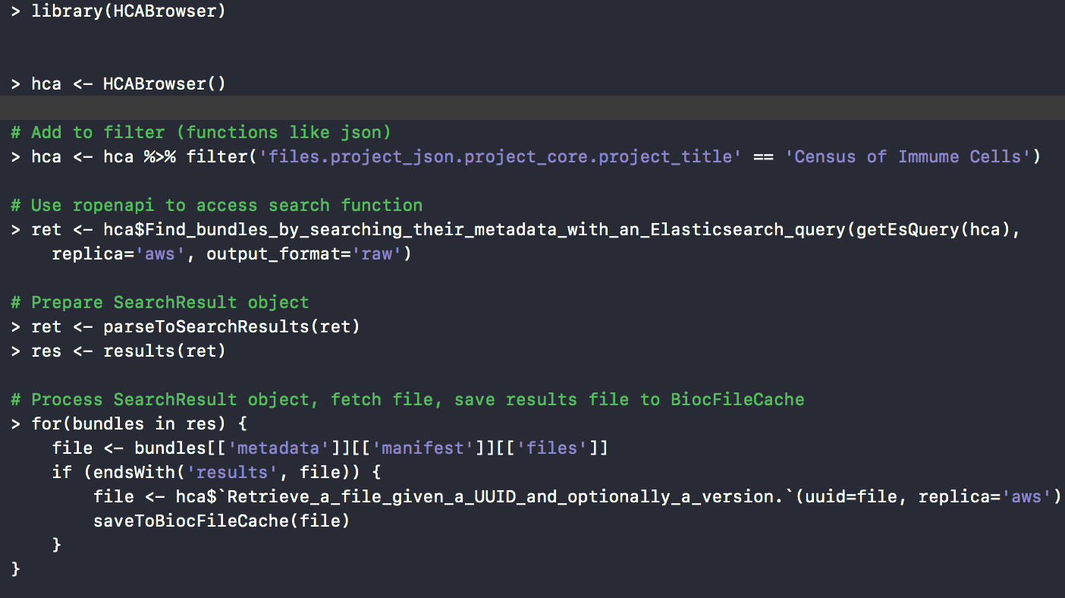
Example

Slide 11
The Azul Backend (digested HCA)
A digested version of the HCA
Responds to updates in the HCA using subscriptions
Simplified API. Allows gleaning helpful information
  e.g. There are 4 projects where the brain is an organ being studied.

Slide 12
The Data Explorer
https://data.humancellatlas.org/explore/projects
Provides a user friendly web interface:
  Construct queries
  Closely examine project info
  Download data
    Direct expression matrix download
    File manifest that can then be fed to the python HCA dcp-cli

Slide 13
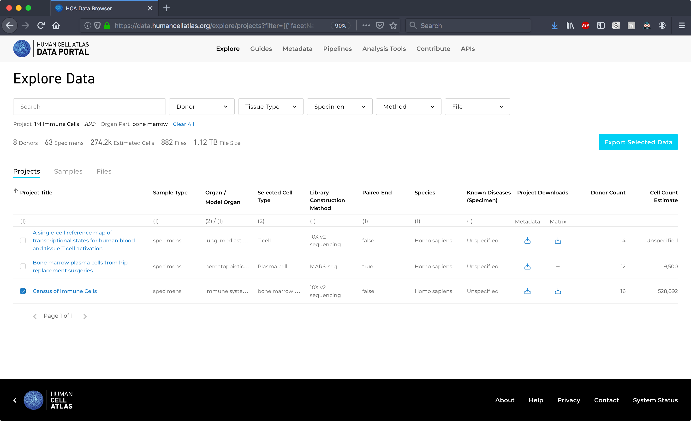
Example

Slide 14
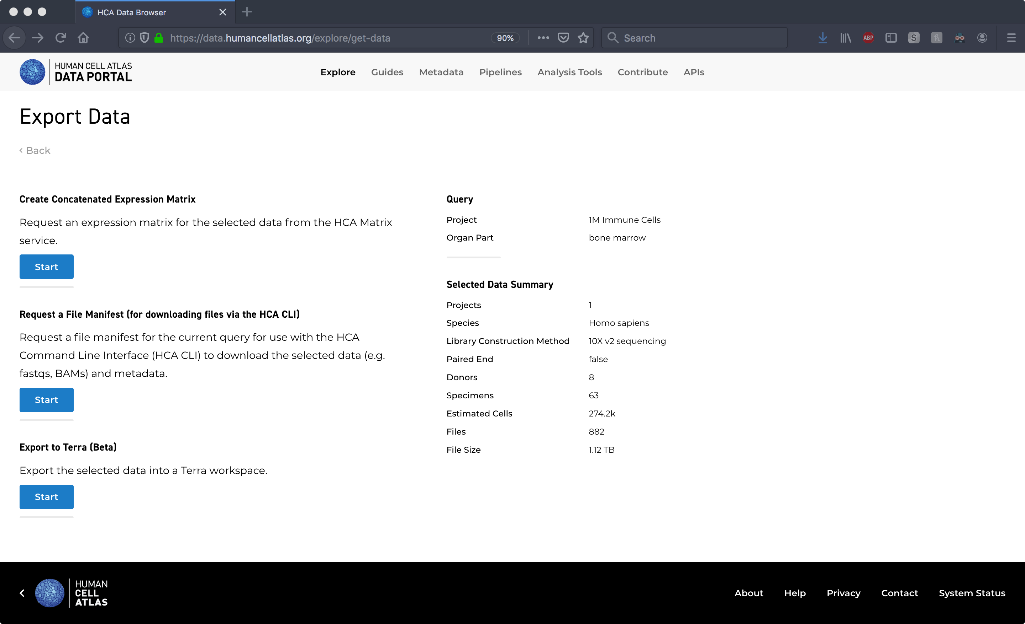
Example

Slide 15
HCAExplorer
A Bioconductor package used to interact with the Azul Backend
Meant to mirror the functionality of the Data Explorer
Provides a programmatic and GUI access using Shiny (still planned)
Package to be added in the Bioconductor 3.10 Release

Slide 16
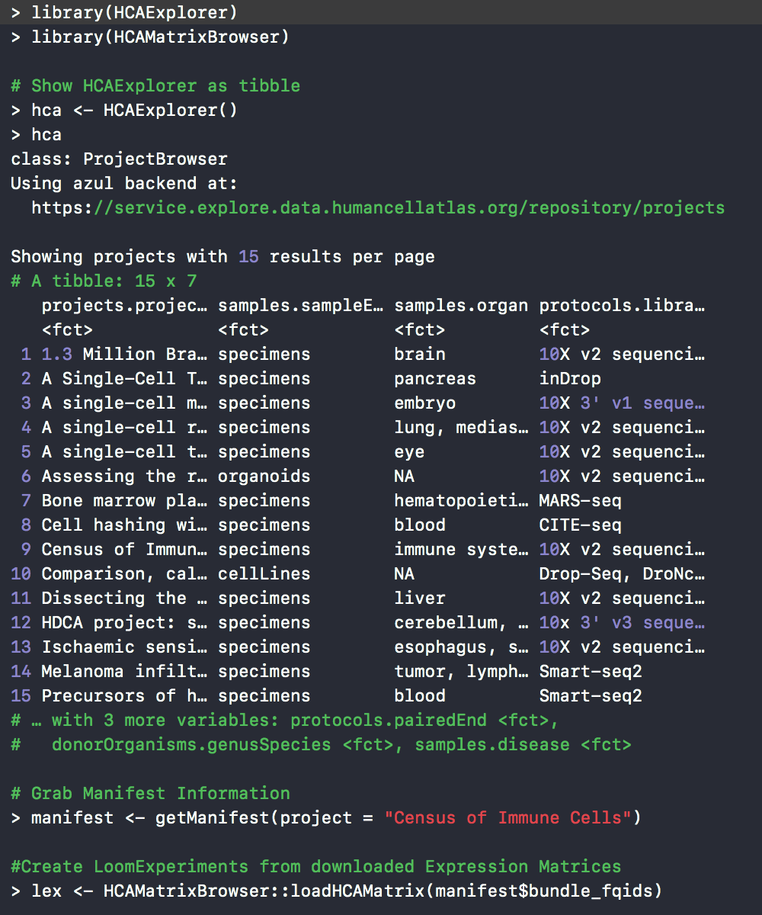
Example

Slide 17
The Matrix Service and the HCAMatrixBrowser
The HCAMatrixBrowser is a package meant to interact with the Matrix Service API
Marcel?

Slide 18
Questions?

